Slide 1



Introduction to Problem Solving
She and They Do Science and Tech

Slide 2
What is problem solving?
For programmers…
“Writing a program that performs a set of tasks and meet all stated constraints”
A problem is not solved if constraints are not met!
Eg. your solution only works for a hundred of data items, but is supposed to work for much bigger datasets

Slide 3
What is problem solving?
What are constraints in programming?

Slide 4



What is problem solving?
What are constraints in programming?
Programming language

Slide 5





What is problem solving?
What are constraints in programming?
Programming language
Platform

Slide 6
What is problem solving?
What are constraints in programming?
Programming language
Platform
Performance

Slide 7
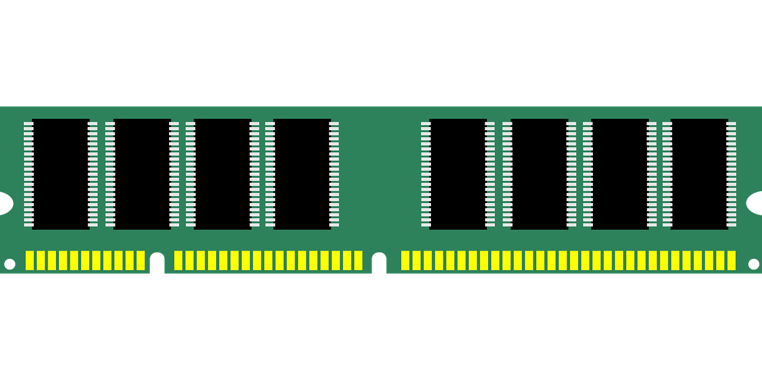
What is problem solving?
What are constraints in programming?
Programming language
Platform
Performance
Memory footprint

Slide 8

What is problem solving?
What are constraints in programming?
Programming language
Platform
Performance
Memory footprint
Include open-source code (optional, required)

Slide 9

What is problem solving?
What are constraints in programming?
Programming language
Platform
Performance
Memory footprint
Include open-source code (optional, required)
Constraints of other people’s code

Slide 10
8 Strategies to Problem Solving

Slide 11
1. Always have a plan

Slide 12
1. Always have a plan
DO NOT:
Type code without a clear direction in mind, hoping to get “lucky”
Miss on considering alternatives

Slide 13
1. Always have a plan
DO:
Plan how to look for a solution
Map all the possible roads to a destination
Stay open to alterations in the plan
Notes:
not necessarily having the solution already! But having a plan on how to proceed methodically

Slide 14

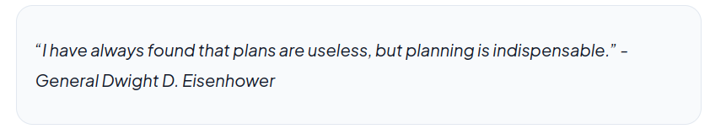
1. Always have a plan
Making plans = setting intermediate goals
Achieving intermediate goals = making progress towards the solution
Less frustration, more positive reinforcement!
Notes:
not necessarily having the solution already! But having a plan on how to proceed methodically

Slide 15
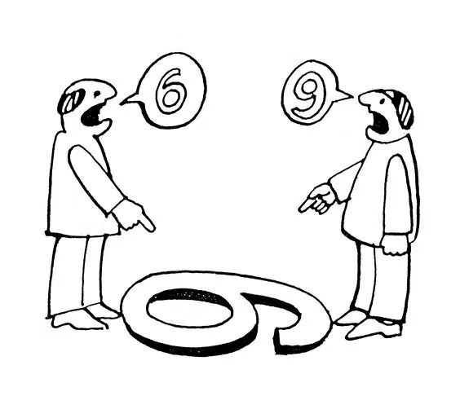
2. Restate the problem

Slide 16
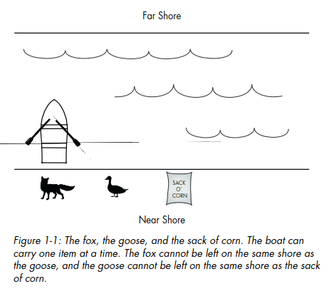
2. Restate the problem

Slide 17
2. Restate the problem
Enumerate all constraints:
1. The farmer can take only one item at a time in the boat.
2. The fox and goose cannot be left alone on the same shore.
3. The goose and corn cannot be left alone on the same shore.
Notes:
Look at all angles (climbing a hill from the easiest side) - How many time do you ask for help and once you explain your problem, suddenly the answer comes to you?

Slide 18
2. Restate the problem
Actions you think you can take:
1.Carry the fox to the far side of the river.
2.Carry the goose to the far side of the river.
3.Carry the corn to the far side of the river.
Notes:
Look at all angles (climbing a hill from the easiest side) - How many time do you ask for help and once you explain your problem, suddenly the answer comes to you?

Slide 19
2. Restate the problem
Enumerate all generic operations:
Row the boat from one shore to the other.
2. If the boat is empty, load an item from the shore.
3. If the boat is not empty, unload the item to the shore.
Notes:
Look at all angles (climbing a hill from the easiest side) - How many time do you ask for help and once you explain your problem, suddenly the answer comes to you?

Slide 20
2. Restate the problem
Restate in more familiar terms (tell your colleague!)
Does not require coding
Look at all angles
Enumerate all possible actions
Enumerate all possible operations
Enumerate all constraints
Notes:
Look at all angles (climbing a hill from the easiest side) - How many time do you ask for help and once you explain your problem, suddenly the answer comes to you?

Slide 21
3. Divide the problem

Slide 22
3. Divide the problem
Divide in steps or phases
Is it quicker to sort 100 files from A-Z or to sort 4 groups of 25 files already split in A-F, G-M, N-S, T-Z?
Lower the difficulty
Use functions

Slide 23
4. Start with what you know

Slide 24
4. Start with what you know
With problem now in sub-tasks, code the ones you already know how to code (or that you have already coded in another project)
A working partial solution may spark ideas about the rest of the problem
It gives an order to your efforts

Slide 25
5. Reduce the problem

Slide 26
5. Reduce the problem
Reduce the scope by adding/removing constraints
Produce a problem you know how to solve
Pinpoint where the remaining difficulty lies
Notes:
if we removed one constraint from the fox/goose puzzle, the answer would be easy

Slide 27
6. Look for analogies

Slide 28
6. Look for analogies
Look for similarities between current problem and problems already solved
fully?
partial?

Slide 29
7. Experiment

Slide 30
7. Experiment
Try things - methodically (≠ from guessing!)
Controlled process
Hypothesize what will happen when certain code is executed
It helps understand something that is not clear
Similar to debugging

Slide 31
8. Don’t get frustrated!

Slide 32

8. Don’t get frustrated!
Frustration feeds itself
Source and destination of frustration is the programmer’s mind
Take a break (get some fresh air)!!

Slide 33
General strategies
Have a plan
Restate the problem
Divide the problem
Start with what you know
Reduce the problem
Look for analogies
Experiment
DON’T GET FRUSTRATED!

Slide 34
Acknowledgement
This presentation, including the images, is based on the book “Think Like a Programmer: An Introduction to Creative Problem Solving” by V. Anton Spraul, and the blog from Damian Demasi https://blog.damiandemasi.com/problem-solving-techniques-to-avoid-yelling-at-your-computer

